Slide 1

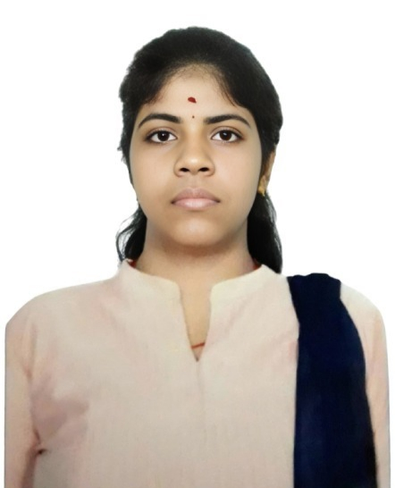
CAPSTONE PROJECT
Crop Recommendation and Climate Analysis using Power BI
Presented By
Student Name: C PUSHPALATHA
College Name: Justice Basheer Ahmed Sayeed College For Women
Department: mca
Email ID: iyappan041987@gmail.com
AICTE Internship Student Registration ID: STU696132c929d891767977673

Slide 2
OUTLINE:
Problem Statement
Proposed System/Solution
System Development Approach
Algorithm & Deployment
Result (Output Image)
Conclusion
Future Scope
References

Slide 3
Problem Statement:
Agriculture productivity depends on several environmental factors such as temperature, rainfall, humidity, soil nutrients (Nitrogen, Phosphorus, Potassium), and soil pH. Farmers often face difficulty in determining which crop is suitable for specific soil and climate conditions. Without proper data analysis, selecting the appropriate crop can lead to low productivity and inefficient resource utilization. Therefore, it is important to analyze environmental conditions and soil nutrients to support better crop selection.

Slide 4
Proposed Solution:
The proposed system aims to analyze agricultural data to understand how environmental factors influence crop suitability. By using data analytics and visualization techniques, the system helps identify relationships between soil nutrients, climate conditions, and different crop types.The solution consists of the following components:
Data Collection:
Collect agricultural data containing environmental and soil parameters such as temperature, rainfall, humidity, soil nutrients (Nitrogen, Phosphorus, Potassium), and soil pH along with the corresponding crop types.
Data Preprocessing:
Clean and organize the dataset to ensure accurate analysis. This includes checking for missing values, verifying data consistency, and preparing the dataset for visualization and analysis
Data Analysis
Analyze the relationships between environmental factors and crop types to understand how climate and soil conditions affect crop growth.
Data Visualization
Use Power BI to create interactive dashboards and visualizations such as pie charts, bar charts, scatter plots, and KPI cards. These visualizations help users easily interpret the data and identify patterns in crop suitability.
Deployment:
Develop an interactive Power BI dashboard that allows users to explore crop-related data using filters and visual charts. The dashboard provides insights into temperature, rainfall, humidity, and soil nutrient requirements for different crops.
Evaluation:
Evaluate the effectiveness of the dashboard by analyzing how well the visualizations help in understanding crop suitability patterns and environmental dependencies. Fine-tune the model based on feedback and continuous monitoring of prediction accuracy.
Result:
The system generates an interactive Power BI dashboard that provides insights into crop distribution, environmental conditions, and soil nutrient requirements, supporting better decision-making in agriculture.

Slide 5
System Approach:
Tools
Used Power BI Desktop
Used to create interactive dashboards and visualizations.
Dataset
Crop Recommendation Dataset from Kaggle.
Visualization Techniques
Pie Charts
Bar Charts
Column Charts
Scatter Plot
KPI Cards and more.
These visualizations help analyze crop distribution and environmental factors affecting crop growth.

Slide 6
Algorithm & Deployment:
Algorithm Selection:
This project uses data analysis and visualization techniques in Power BI instead of machine learning algorithms. The goal is to analyze relationships between environmental factors and crop types to understand crop suitability under different conditions.
Data Input:
The dataset contains agricultural parameters such as Nitrogen (N), Phosphorus (P), Potassium (K), temperature, humidity, rainfall, soil pH, and crop label. These features represent environmental and soil conditions required for different crops.
Training Process:
The dataset is imported into Power BI, where the data is cleaned and processed. Aggregation techniques such as averages are used to analyze environmental factors and generate meaningful visual insights.
Prediction Process:
The system analyzes patterns between environmental factors and crop types using interactive charts and visualizations. These visualizations help identify suitable environmental conditions for different crops and support better agricultural decision-making.

Slide 7
Result:
The Power BI dashboard presents visual insights into crop suitability based on environmental and soil parameters such as temperature, rainfall, humidity, soil nutrients, and soil pH. The visualizations help identify patterns and relationships between climate conditions and different crops. These insights support better understanding of environmental requirements for crop growth and assist in agricultural decision-making.
GitHub Link: https://github.com/cpushpalatha9/Crop-Recommendation-PowerBI-Dashboard.git
Dataset Link: https://www.kaggle.com/datasets/siddharthss/crop-recommendation-dataset

Slide 8
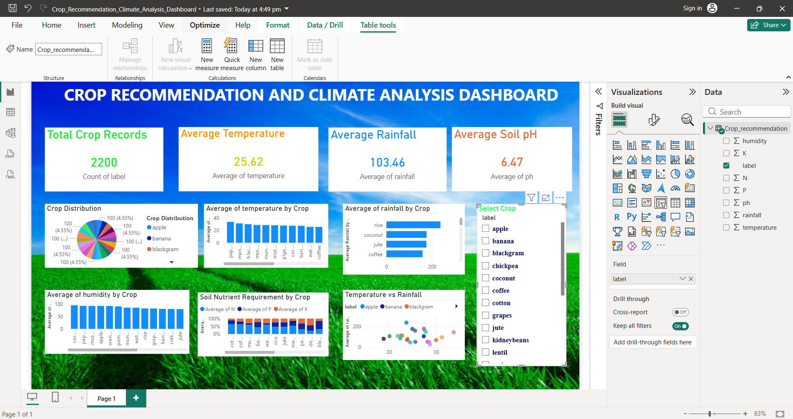
Result:
Crop Recommendation and Climate Analysis using Power BI

Slide 9
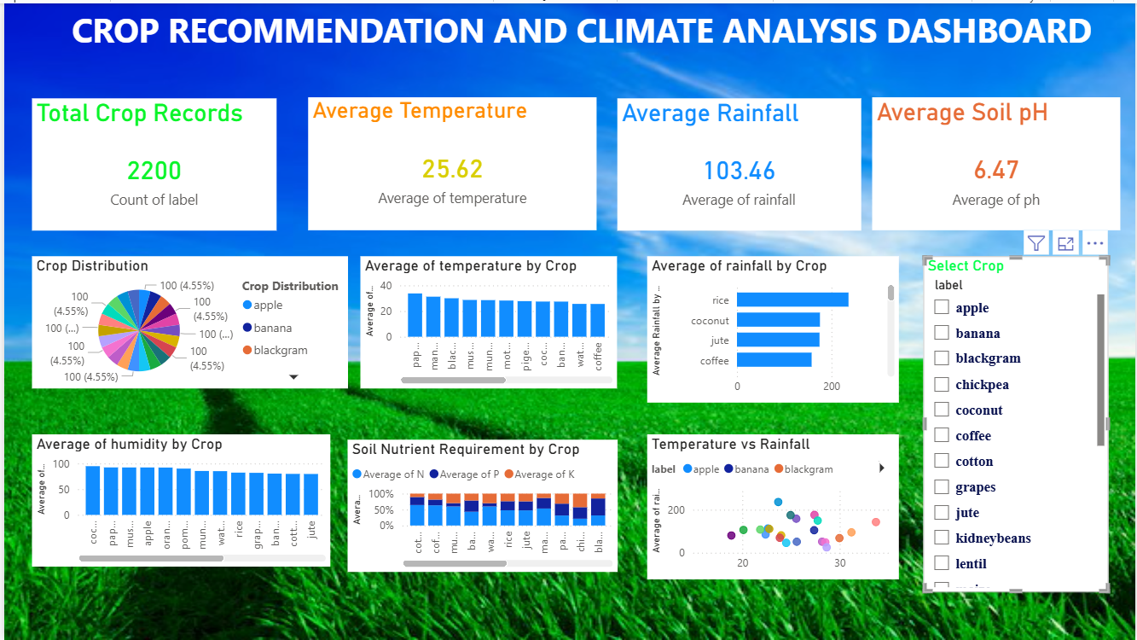
Result:
Crop Recommendation and Climate Analysis using Power BI

Slide 10
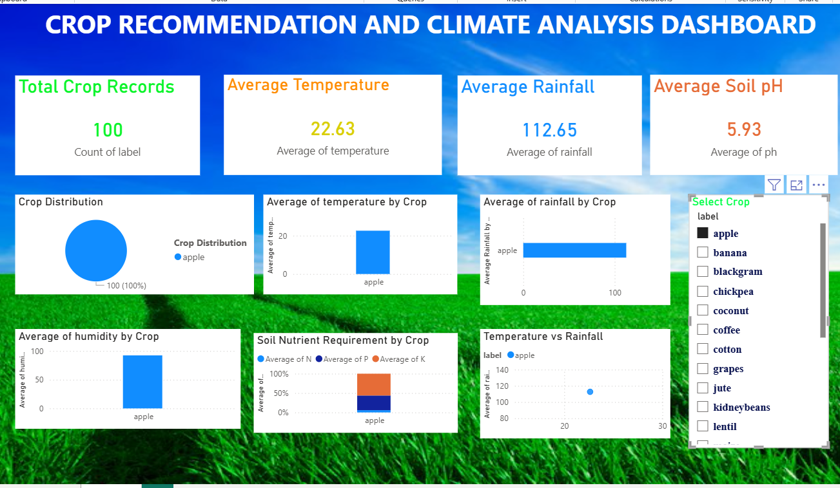
Result:
Crop Recommendation and Climate Analysis using Power BI

Slide 11
Conclusion:
The project analyzes environmental factors such as temperature, rainfall, humidity, soil nutrients, and soil pH to understand crop suitability. The Power BI dashboard effectively visualizes the relationships between these factors and different crop types, helping identify suitable environmental conditions for crop growth. This analysis supports better agricultural planning and data-driven decision making in farming.

Slide 12
Future scope:
The system can be improved by integrating real-time weather and soil data to enhance crop analysis. Advanced technologies such as machine learning models can be applied to automatically recommend suitable crops based on environmental conditions. The dashboard can also be expanded to cover multiple regions to support large-scale agricultural planning and decision-making.

Slide 13
References:
Kaggle – Crop Recommendation Dataset https://www.kaggle.com/datasets/siddharthss/crop-recommendation-dataset
(Dataset used for crop and environmental data analysis.)
Microsoft Power BI Documentation
https://learn.microsoft.com/power-bi/
(Used for understanding Power BI visualization and dashboard creation.)
Microsoft AI Skills Navigator / Elevate AICTE Internship Resourceshttps://aiskillsnavigator.microsoft.com(Learning materials used during the internship program.)

Slide 14
Thank You

